Slide 1
Wikipedia Article Classification
The goal of the study is to build a binary classification model for a repository of Wikipedia articles, we have to classify the articles as featured and non featured.
This model can be used on a wide range of data from extracting the text from the last revisions

Slide 2
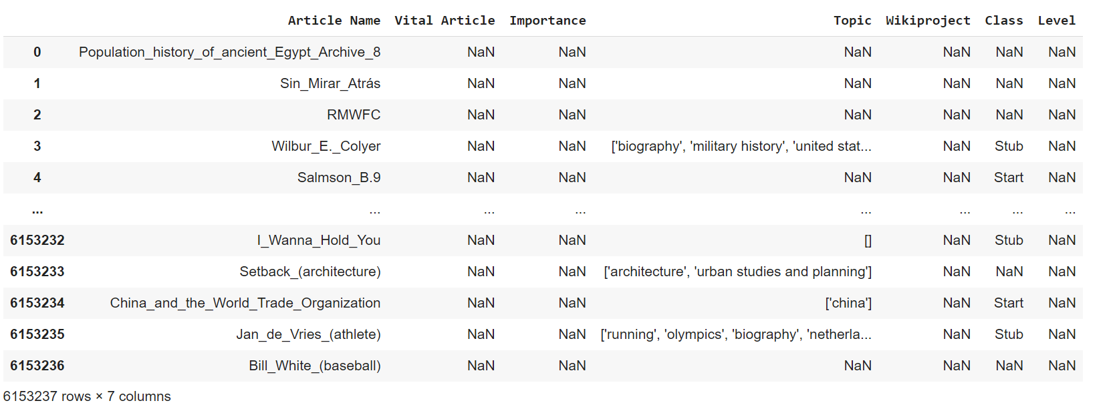
Data
We have a dataset of article description which has the articles details
The dataset contains the article name , importance, class and level
Each article’s data contains its full revision history (in XML format).

Slide 3
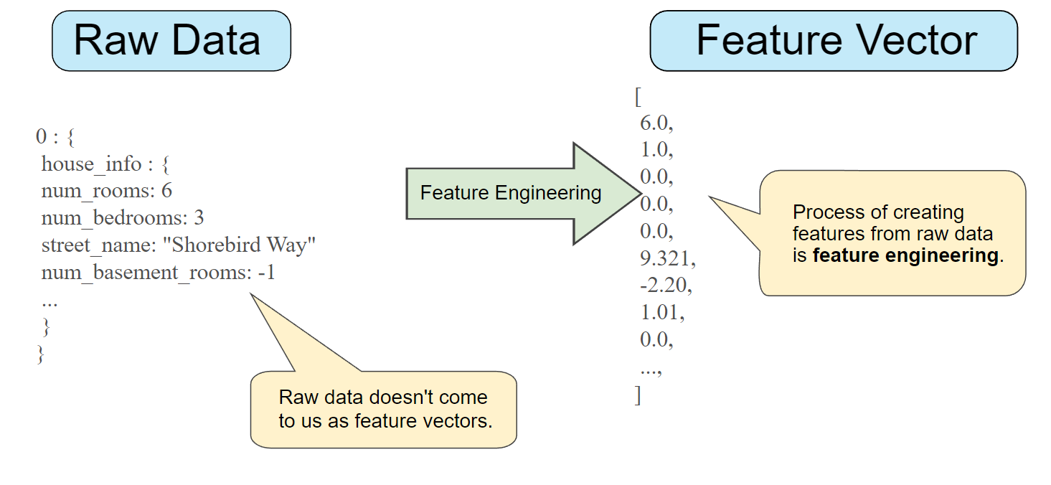
process
Each article’s data contains its full revision history (in XML format). So we extract the text from the last revision.
We used Wikipedia-API to extract the text and parse the xml files. Also, find the number of revisions and distinct users for each article.
For each article we find the following and represent them as a vector.
1. Number of words in the last revision.
2. Total number of revisions.
3. Number of distinct users.
We add all these features as columns to the dataset

Slide 4
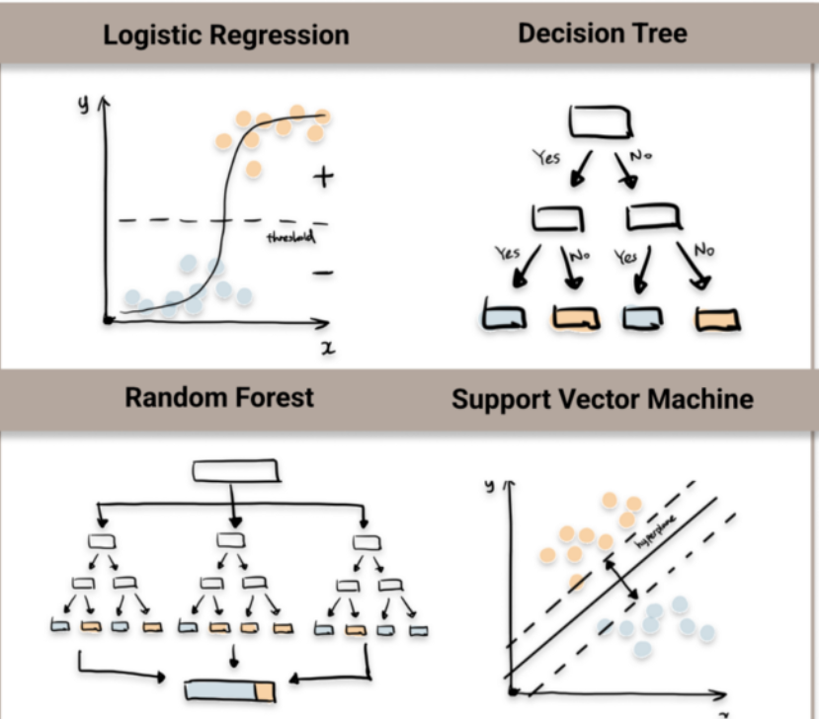
modelling
With the features extracted from the article name as features and class as target, split the data into tarin and test set. Created different models to train and evaluate the model on the test set.
The different classification models used are:
1
Logistic Regression
2
Decision Tree
3
Random Forest
4
Support Vector Machine(SVM)

Slide 5
Evaluation
We evaluated the all the models and got the accuracy scores for all and found the best model for the dataset. Also, found did we get the same accuracy for all the models
1
Found the accuracy for all the models
2
Got the best scores of all the models
3
Got the best parameters from all the 4 models
Got the accuracy score of 92.66% with SVM model and the we found the number of words as the most important feature
We have deployed the model using streamlit with which we can predict any article as featured or non featured

Slide 6


